Slide 1

ECE 281 Lesson 34
1

Slide 2
Lesson 34 Outline
Do Time Logs!
LSN 35 Lab 4 Mega PreLab
J-Type Instructions
Controller
Lab 4 Mega Prelab Preview

Slide 3
Primary Objective for Lessons 33, 34, and Lab 4
Demonstrate the ability to design and test a microarchitecture (datapath and control unit) to implement a simple computer architecture.

Slide 4
The glue that brings
it all together!
Abstraction

Slide 5
Multiple MIPS microarchitectures
Recall: Multiple microarchitectures for a single architecture
Single cycle
Multi-cycle
Pipelined

Slide 6
Review – Two Parts of CPU
Microarchitecture…we’ll look at in two parts
Datapath – operates on words of data
includes memories, registers, ALU, muxes, etc.
How many bits for MIPS datapath?
Control – get current instruction from datapath and tells datapath how to execute

Slide 7
Computer Block Diagram
CPU
Memory
Input/
Output
Outside
World
Control
Datapath
ALU
Control Bus
Data Bus
Address Bus

Slide 8
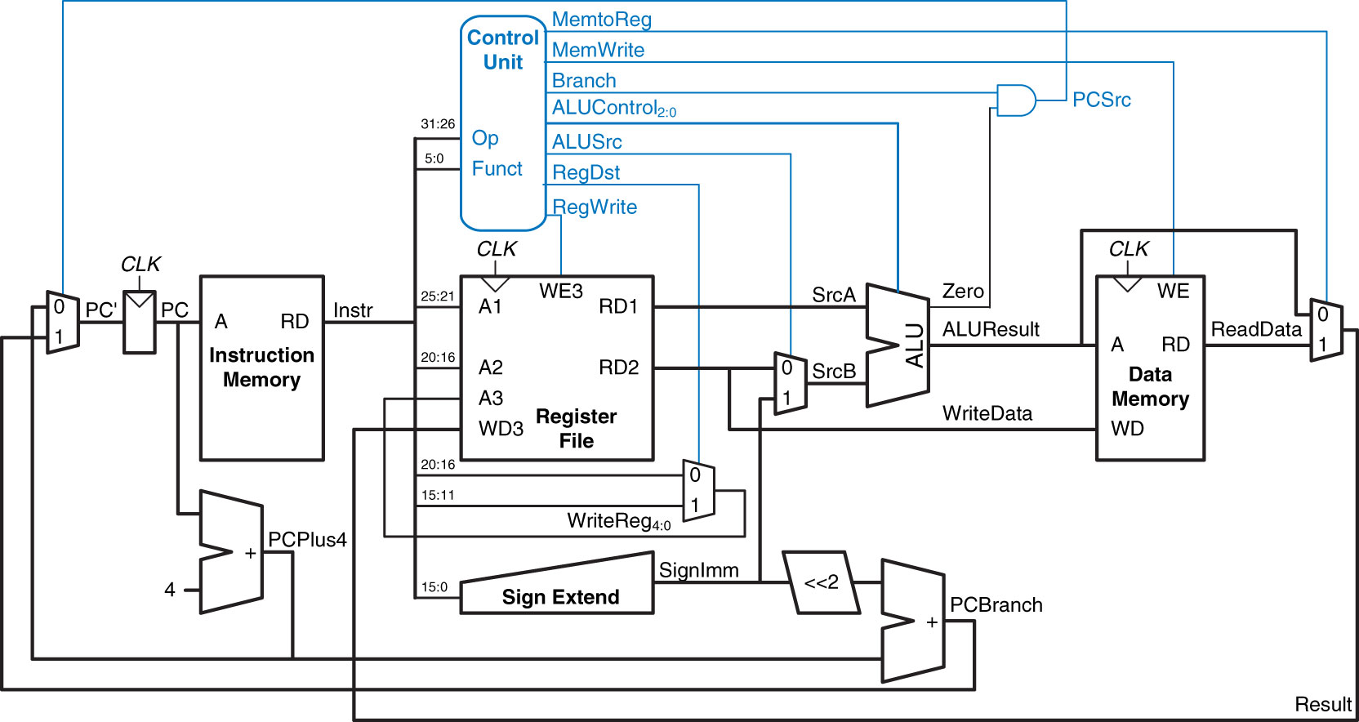
Complete Single-Cycle MIPS Processor
Control Unit – This Lesson
Datapath
Instruction
Memory
Data
Memory
Figure 7.11 Complete single-cycle MIPS processor
Copyright © 2013 Elsevier Inc. All rights reserved.

Slide 9
Review
Instructions implemented last class
R-type arithmetic/logic: add, sub, and, or, slt
Memory: lw, sw
Branches: beq
Need HW to support all 5 addressing modes:
Register Only (R-types)
Immediate (some I-types: addi, lui, etc)
Base (base addr + SignImm offset, e.g., lw, sw, etc)
PC relative (conditionals)
Pseudo-direct (jumps)

Slide 10
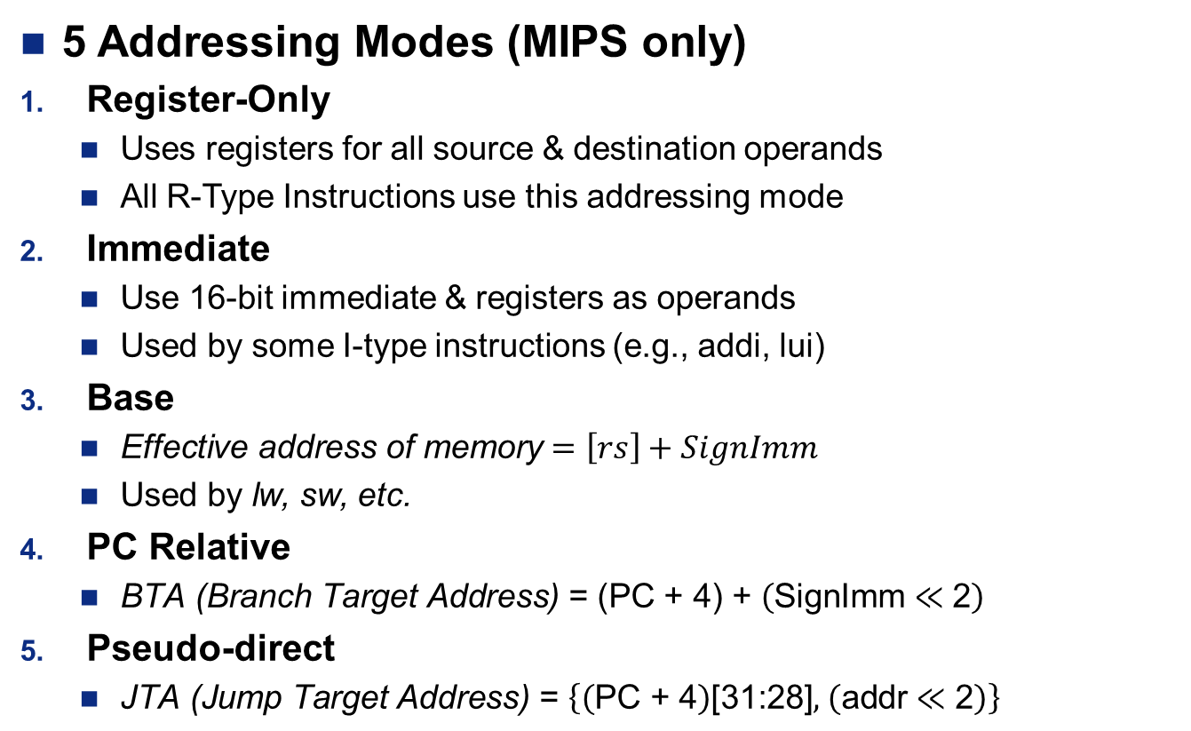
Addressing Modes
5 Addressing Modes (MIPS only)
Register-Only
Uses registers for all source & destination operands
All R-Type Instructions use this addressing mode
Immediate
Use 16-bit immediate & registers as operands
Used by some I-type instructions (e.g., addi, lui)
Base
$\text{Effective} \text{address} \text{of} \text{memory}=\left[rs\right]+SignImm$
Used by lw, sw, etc.
PC Relative
$\text{BTA}\text{ (}\text{Branch} \text{Target} \text{Address}\text{) }\text{= }\text{(}\text{PC} \text{+} \text{4}\text{)} \text{+} \left(\text{SignImm}≪\text{2}\right)$
Pseudo-direct
$\text{J}\text{TA}\text{ (}\text{Jump} \text{Target} \text{Address}\text{) }\text{= }\left\{\left(\text{PC}\text{ + 4}\right)\text{[31:28]}\text{, }\left(\text{addr}≪\text{2}\right)\right\}$

Slide 11
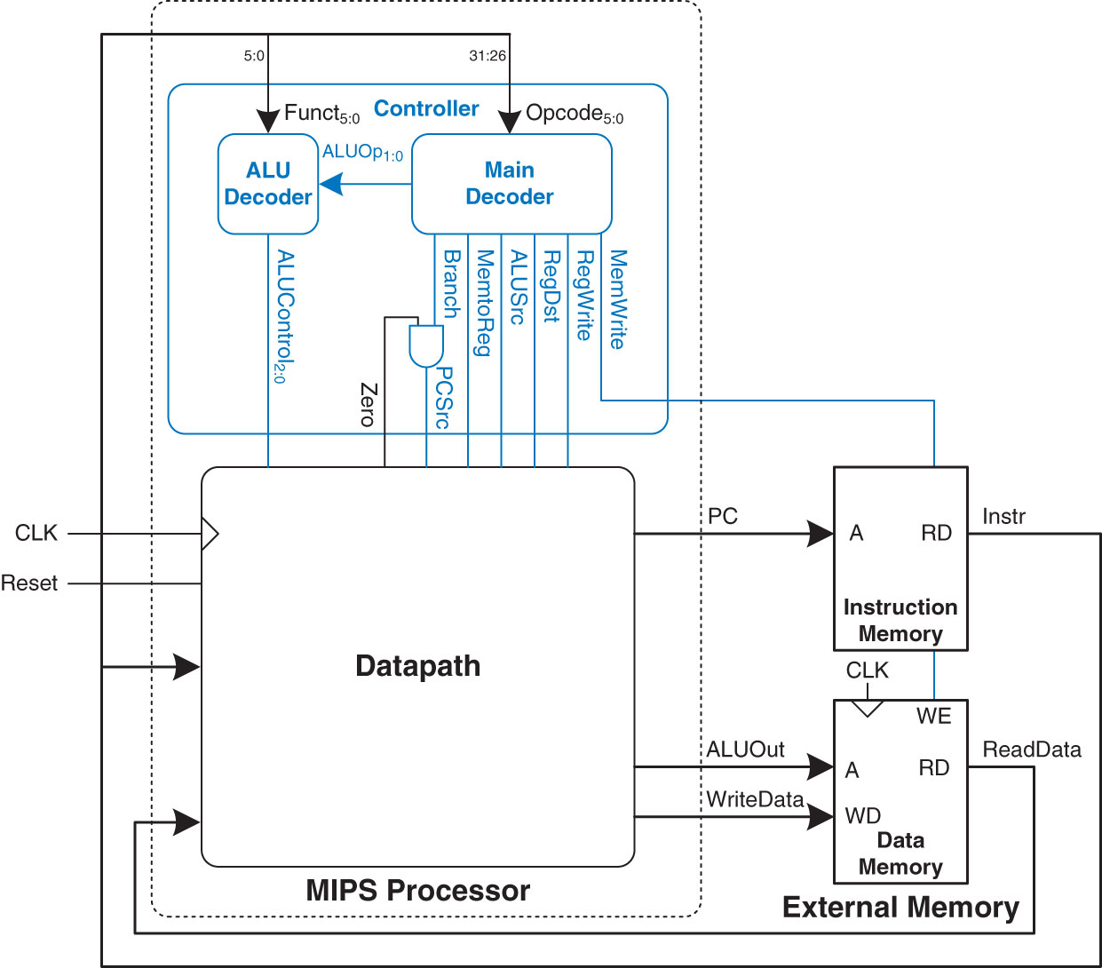
MIPS Single Cycle Processor
for Lab 4
Control Unit – This Lesson
Figure 7.59 MIPS single-cycle processor interfaced to external memory
Copyright © 2013 Elsevier Inc. All rights reserved.

Slide 12
Design Process - Datapath
Start with H/W for state elements (memory and arch. state)
Add blocks of combinatorial logic between state elements
New state computed on current state
Again, like creating a giant Moore FSM!
Need HW to support all 5 addressing modes:
Register Only (R-types)
Immediate (some I-types: addi, lui, etc)
Base (base addr + SignImm offset, e.g., lw, sw, etc)
PC relative (conditionals)
Pseudo-direct (jumps)

Slide 13
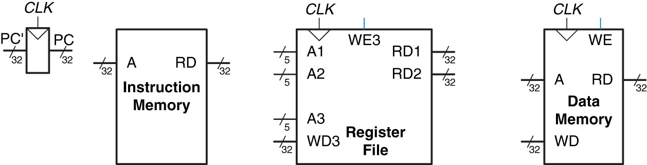
State Elements of MIPS
Processor
Register File – can do two reads at once
A1 ➔ RD1 A2 ➔ RD2
A3 ➔ WD3 and is Controlled by WE
Reads - combinatorial
Writes - active on rising edge of CLK and are controlled by WE
Figure 7.1 State elements of MIPS processor
Copyright © 2013 Elsevier Inc. All rights reserved.

Slide 14
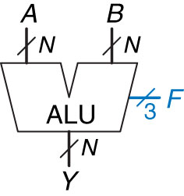
Arithmetic Logic Unit - ALU
F_{2:0} | Function
000 | A & B
001 | A | B
010 | A + B
011 | not used
100 | A & ~B
101 | A | ~B
110 | A - B
111 | SLT

Slide 15
I-Type Instructions
I-Type Instructions – Immediate Type
I-Type
op | rs | rt | imm
6 bits | 5 bits | 5 bits | 16 bits
I-Type
op | rs | rt | imm
6 bits | 5 bits | 5 bits | 16 bits
31:26 | 25:21 | 20:16 | 15:0

Slide 16
I-Type Instruction lw rt, imm(rs)
lw rt, imm(rs) # Uses BASE addressing mode
[rt] = [ADDR]
ADDR = [rs] + SignImm
I-Type
op | rs | rt | imm
6 bits | 5 bits | 5 bits | 16 bits
31:26 | 25:21 | 20:16 | 15:0
sw rt, imm(rs)
[ADDR] = [rt]

Slide 17
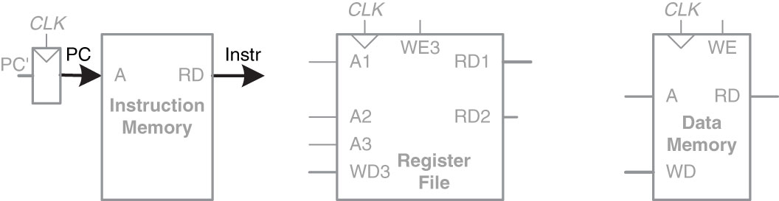
I-Type Instruction
lw rt, imm(rs)
Step 1:
I-Type
op | rs | rt | imm
6 bits | 5 bits | 5 bits | 16 bits
31:26 | 25:21 | 20:16 | 15:0
Figure 7.2 Fetch instruction from memory
Copyright © 2013 Elsevier Inc. All rights reserved.

Slide 18
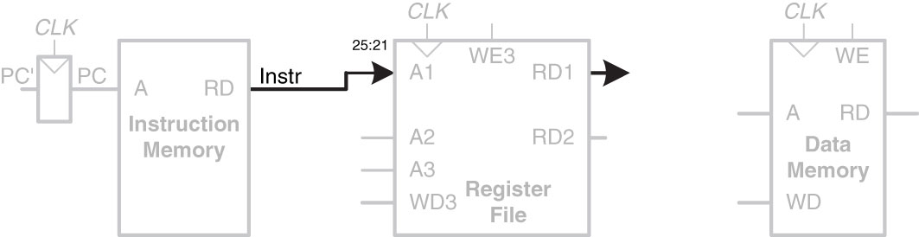
I-Type Instruction
lw rt, imm(rs)
Step 2:
Figure 7.3 Read source operand (rs) from register file
I-Type
op | rs | rt | imm
6 bits | 5 bits | 5 bits | 16 bits
31:26 | 25:21 | 20:16 | 15:0
Copyright © 2013 Elsevier Inc. All rights reserved.

Slide 19
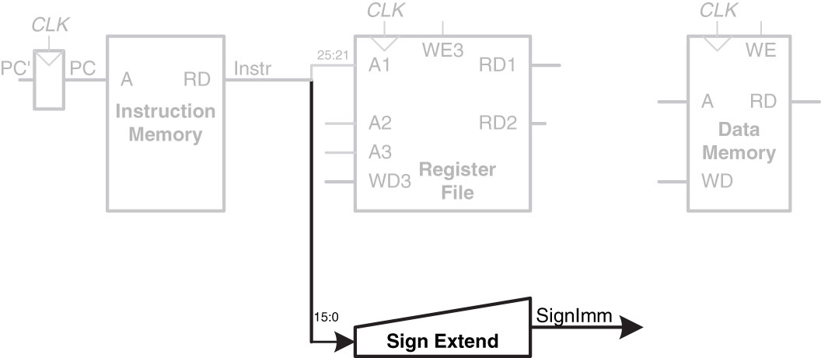
I-Type Instruction
lw rt, imm(rs)
I-Type
op | rs | rt | imm
6 bits | 5 bits | 5 bits | 16 bits
31:26 | 25:21 | 20:16 | 15:0
Step 3:
Figure 7.4 Sign-extend the immediate (SignImm)
Copyright © 2013 Elsevier Inc. All rights reserved.

Slide 20
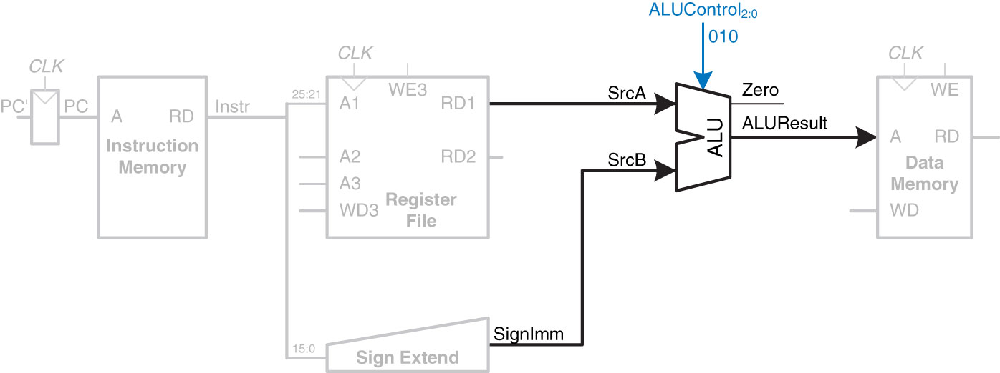
I-Type Instruction
lw rt, imm(rs)
F_{2:0} | Function
000 | A & B
001 | A | B
010 | A + B
011 | not used
100 | A & ~B
101 | A | ~B
110 | A - B
111 | SLT
ADDR = [rs] + SignImm
Step 4:
I-Type
op | rs | rt | imm
6 bits | 5 bits | 5 bits | 16 bits
31:26 | 25:21 | 20:16 | 15:0
Figure 7.5 Compute memory address
Copyright © 2013 Elsevier Inc. All rights reserved.

Slide 21
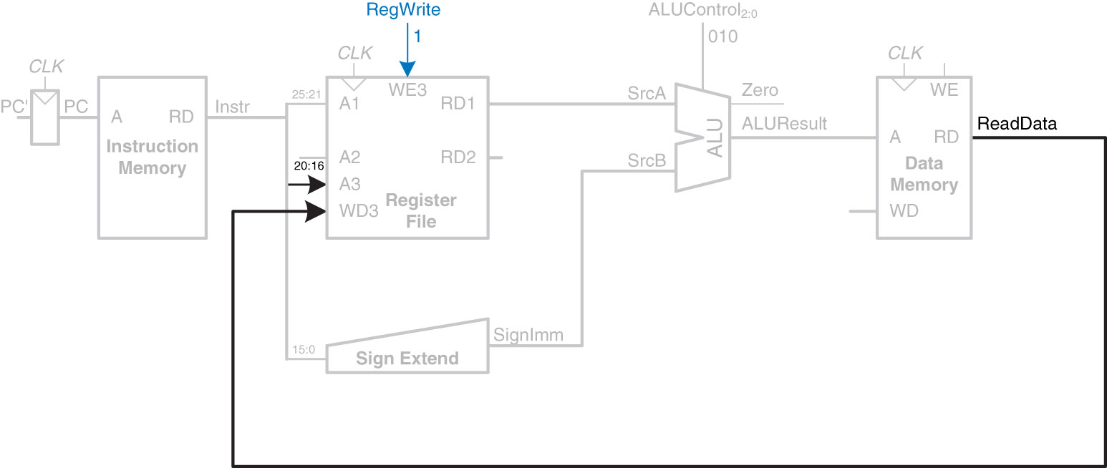
I-Type Instruction
lw rt, imm(rs)
[rt] = [ADDR]
Step 5:
I-Type
op | rs | rt | imm
6 bits | 5 bits | 5 bits | 16 bits
31:26 | 25:21 | 20:16 | 15:0
Figure 7.6 Write data back to register file
Copyright © 2013 Elsevier Inc. All rights reserved.

Slide 22
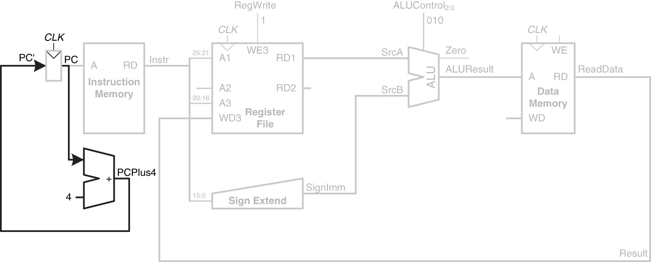
Determine address of next Instruction for PC
Step 6:
I-Type
op | rs | rt | imm
6 bits | 5 bits | 5 bits | 16 bits
31:26 | 25:21 | 20:16 | 15:0
Figure 7.7 Determine address of next instruction for PC
Copyright © 2013 Elsevier Inc. All rights reserved.

Slide 23
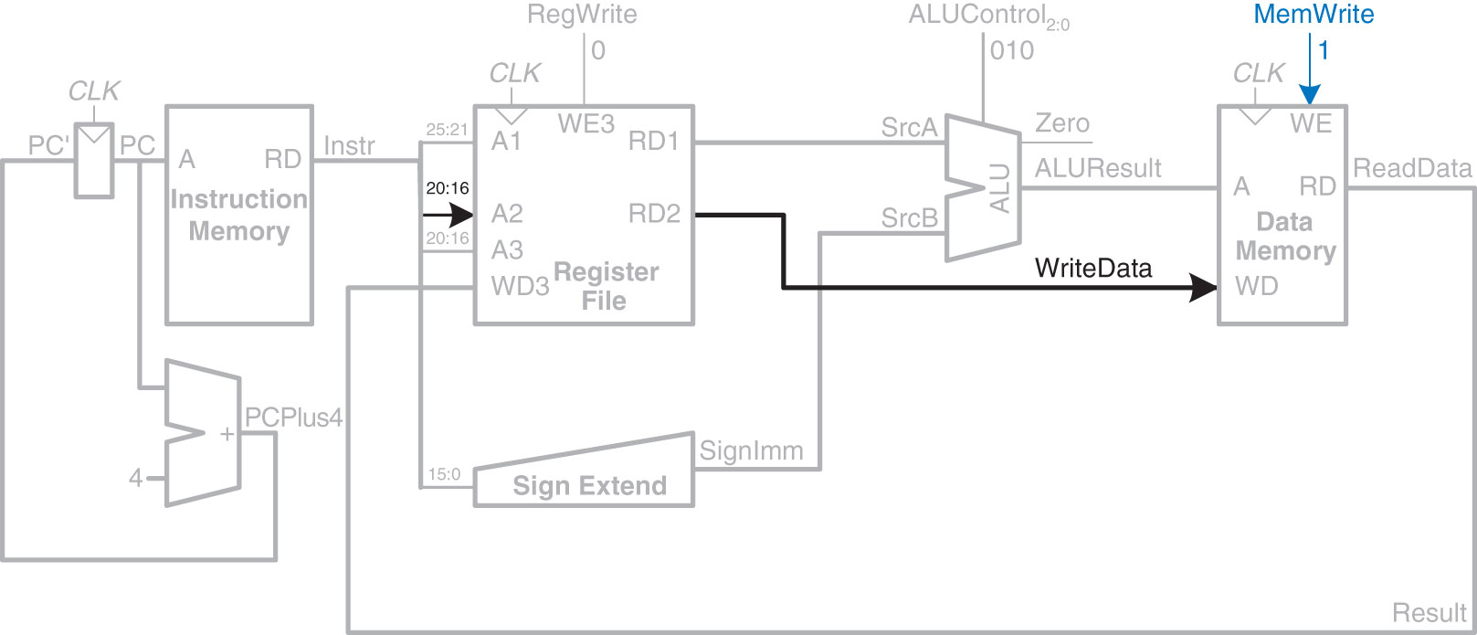
I-Type Instruction
Enhancements for SW
Figure 7.8 Write data to memory for sw instruction
I-Type
op | rs | rt | imm
6 bits | 5 bits | 5 bits | 16 bits
31:26 | 25:21 | 20:16 | 15:0
Copyright © 2013 Elsevier Inc. All rights reserved.
sw rt, imm(rs)
[ADDR] = [rt]
ADDR = [rs] + SignImm

Slide 24
R-Type Instructions
R-Type Instructions – Register Type
R-Type
op | rs | rt | rd | shamt | funct
6 bits | 5 bits | 5 bits | 5 bits | 5 bits | 6 bits
31:26 | 25:21 | 20:16 | 15:11 | 10:6 | 5:0
R-Type
op | rs | rt | rd | shamt | funct
6 bits | 5 bits | 5 bits | 5 bits | 5 bits | 6 bits

Slide 25
R-Type Instructions add rd, rs, rt
add rd, rs, rt
# Uses Register only addressing mode
[rd] = [rs] + [rt]
R-Type
op | rs | rt | rd | shamt | funct
6 bits | 5 bits | 5 bits | 5 bits | 5 bits | 6 bits
31:26 | 25:21 | 20:16 | 15:11 | 10:6 | 5:0

Slide 26
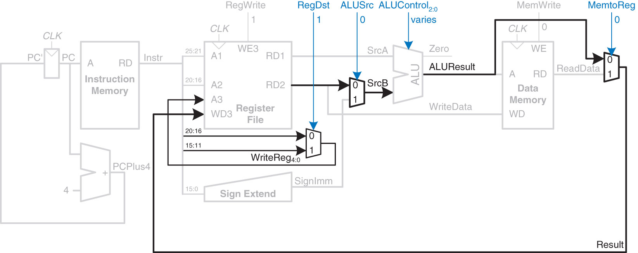
Datapath Enhancements for
R-Type Instruction
Figure 7.9 Datapath enhancements for R-type instruction
Steps for R-Type Instructions
(ex ADD: add rd, rs, rt):
Read 2 Registers (rs, rt)
Do ALU Op (Varies with ALUControl)
Write/Register
Add a Destination (rd)
R-Type
op | rs | rt | rd | shamt | funct
6 bits | 5 bits | 5 bits | 5 bits | 5 bits | 6 bits
31:26 | 25:21 | 20:16 | 15:11 | 10:6 | 5:0
Copyright © 2013 Elsevier Inc. All rights reserved.

Slide 27
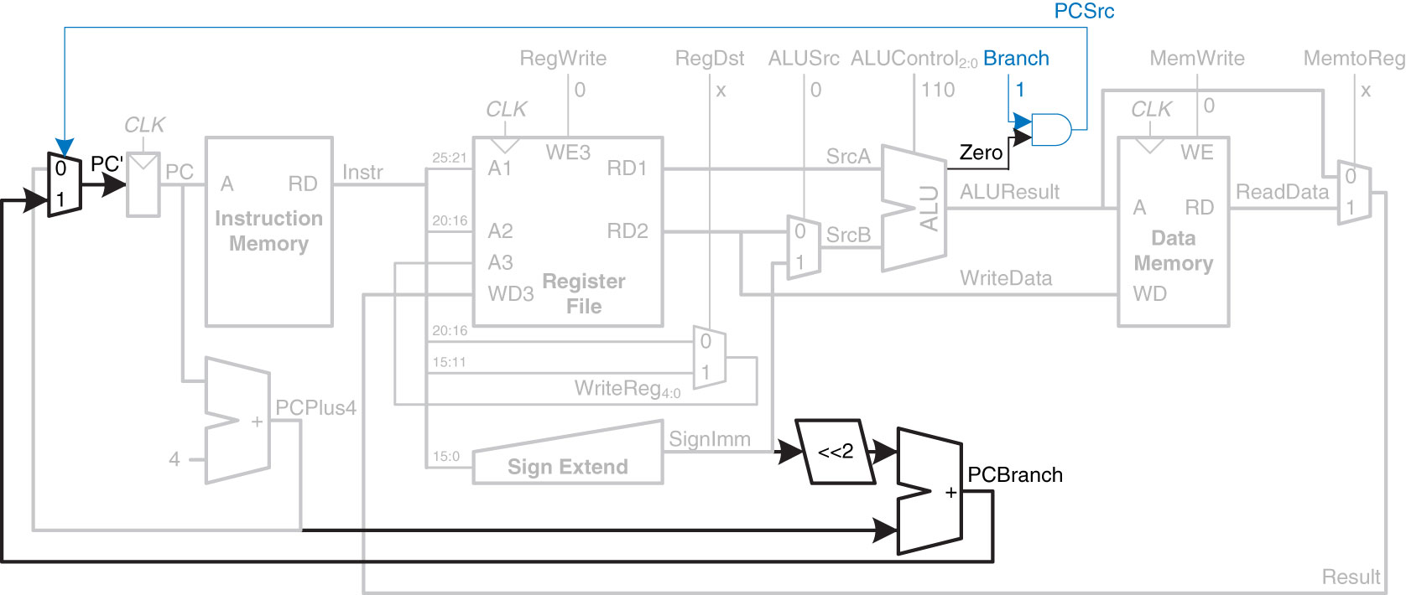
Datapath Enhancements for
BEQ Instruction
Figure 7.10 Datapath enhancements for beq instruction
BTA = (PC + 4) + (SignImm * 4)
beq rs, rt, label
# Uses PC-relative addressing mode
If ( [rs] == [rt] )
PC = BTA
Next Instruction
Word aligned offset
Copyright © 2013 Elsevier Inc. All rights reserved.

Slide 28
Complete Single-Cycle MIPS Processor
Control Unit – This Lesson
Figure 7.11 Complete single-cycle MIPS processor
Copyright © 2013 Elsevier Inc. All rights reserved.

Slide 29
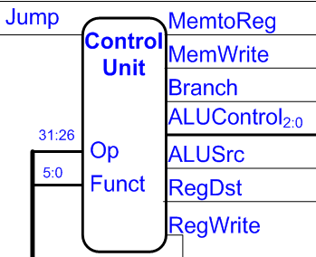
Control Unit
Computes control signals from:
Opcode
Funct code
Two main classes of instructions:
R-Type (uses funct)
Others
So we break problem into two parts

Slide 30
Control Unit
Controller has two parts:
Main Decoder
Takes opcode and generates:
Control signals
ALUOp_{1:0}
ALU Decoder –
Fed by ALUOp_{1:0} signal
with Funct_{5:0} tells ALU the appropriate ALUControl_{2:0} signal
2 Decoders tied together by 2 bit ALUOp signal
Copyright © 2013 Elsevier Inc. All rights reserved.

Slide 31
Control Unit
ALU Functions
F_{2:0} | Function
000 | A & B
001 | A | B
010 | A + B
011 | not used
100 | A & ~B
101 | A | ~B
110 | A – B
111 | SLT
ALU Op meanings
alu_op_{1:0} | Meaning
00 | Add
01 | Subtract
10 | Look at Funct field
11 | not used
alu_op_{1:0} | Funct_{5:0} | ALUControl_{2:0}
00 | X | 010 (add)
X1 | X | 110 (subtract)
1X | 100000 (Add) | 010 (add)
1X | 100010 (sub) | 110 (subtract)
1X | 100100 (and) | 000 (and)
1X | 100101 (or) | 001 (or)
1X | 101010 (slt) | 111 (set less than)
2 Decoders tied together by 2 bit ALUOp signal
Copyright © 2013 Elsevier Inc. All rights reserved.

Slide 32
Control Unit
Our Controller (currently) outputs 6 signals:
Reg_Write – are we writing to a register?
Reg_Dst – 0 for I-Type, 1 for R-Type
ALU_Src – 1 for I-Type, 0 for R-Type (generally)
Branch – are we branching?
Mem_Write – are we writing to memory?
Mem_to_Reg – are we moving info from memory to a register?
Controller has two inputs:
Opcode_{5:0}
Funct_{5:0}

Slide 33
Trace signal path – lw, sw
ADDR = [rs] + SignImm
lw rt, imm(rs) # Uses BASE addressing mode
[rt] = [ADDR]
sw rt, imm(rs)
[ADDR] = [rt]
Fill Out Table
I-Type
op | rs | rt | imm
6 bits | 5 bits | 5 bits | 16 bits
31:26 | 25:21 | 20:16 | 15:0
Figure 7.11 Complete single-cycle MIPS processor
Copyright © 2013 Elsevier Inc. All rights reserved.

Slide 34
Trace signal path – OR
R-Type
op | rs | rt | rd | shamt | funct
6 bits | 5 bits | 5 bits | 5 bits | 5 bits | 6 bits
31:26 | 25:21 | 20:16 | 15:11 | 10:6 | 5:0
Figure 7.11 Complete single-cycle MIPS processor
Copyright © 2013 Elsevier Inc. All rights reserved.

Slide 35
Single-Cycle Datapath
Example: OR
Copyright © 2013 Elsevier Inc. All rights reserved.

Slide 36
Trace signal path – beq
Figure 7.11 Complete single-cycle MIPS processor
Copyright © 2013 Elsevier Inc. All rights reserved.

Slide 37
J-Type Instructions
J-Type Instructions – Register Type
J-Type
op | addr
6 bits | 26 bits
31:26 | 25:0

Slide 38
Extended Functionality: j
Copyright © 2013 Elsevier Inc. All rights reserved.

Slide 39
Extended Functionality: j
Copyright © 2013 Elsevier Inc. All rights reserved.

Slide 40
MIPS Single-Cycle Processor
(with all 5 addressing modes supported)
Control Unit – This Lesson

Slide 41
MIPS Single Cycle Processor
for Lab 4
Control Unit – This Lesson
Figure 7.59 MIPS single-cycle processor interfaced to external memory
Copyright © 2013 Elsevier Inc. All rights reserved.

Slide 42
Wrap up
What is the Difference between OR and ORI?
OR - R-Type instruction that ORs two registers
ORI – I-Type instruction that ORs one register with one 16-bit zero extended immediate
Logical ops use ZeroImm instead of SignImm
ADDI is a math operation and does use sign extended immediate (SignImm)
Memory WE control signals (e.g., MemWrite) always matter!
MUX control signals sometimes can be don’t care (‘X’)
Keep control of your control signals!

Slide 43
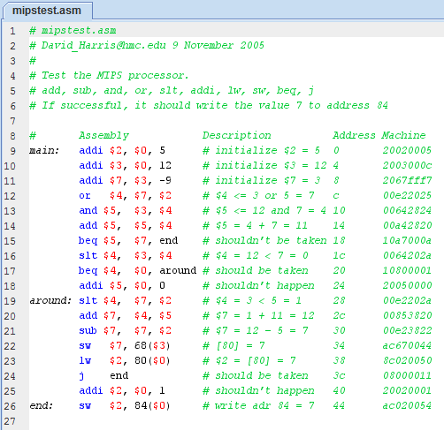
Getting the right machine code from MARS…

Slide 44
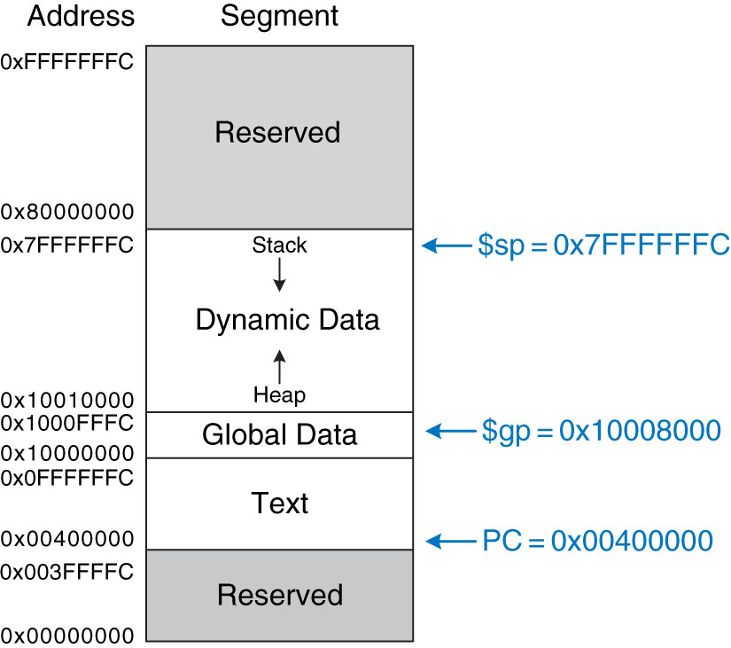
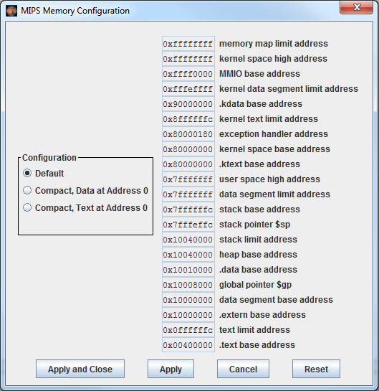
Default MIPS Memory Map
MARS Settings → Memory Configuration
Figure 6.31 MIPS memory map
Copyright © 2013 Elsevier Inc. All rights reserved.

Slide 45
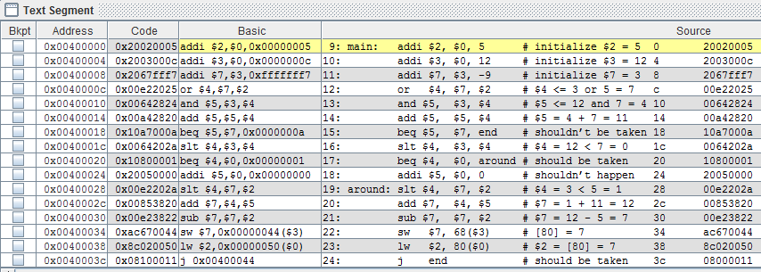
Using Default Memory Map
Jump instructions do not point to the correct address!

Slide 46
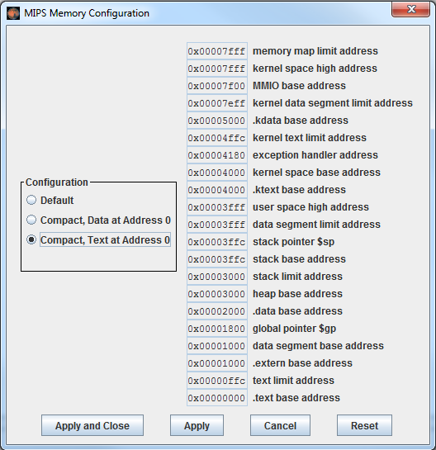
Change MARS Memory Settings

Slide 47
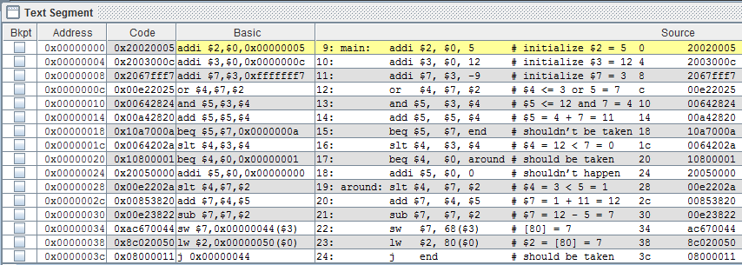
Using Compact Memory Map
Jump instructions now point to the correct address!

Slide 48
MIPS Single Cycle Processor
for Lab 4
Figure 7.59 MIPS single-cycle processor interfaced to external memory
Copyright © 2013 Elsevier Inc. All rights reserved.

Slide 49
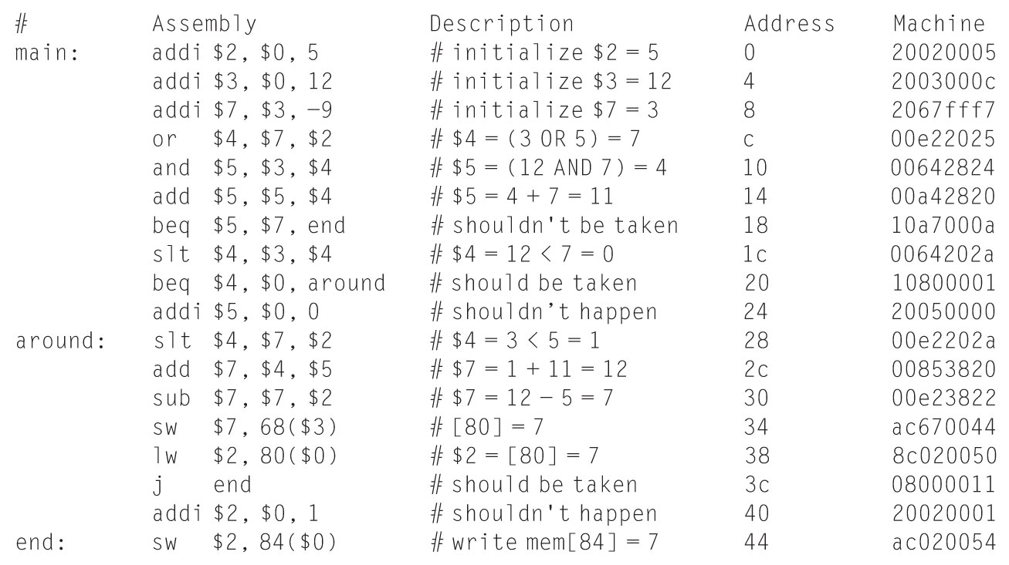
MIPS Test Program
mipstest.asm
Figure 7.60 Assembly and machine code for MIPS test program
Copyright © 2013 Elsevier Inc. All rights reserved.

Slide 50
Table 1 - First sixteen cycles of executing lab4_mipstest.asm
Cycle | reset | pc | instr | branch | src_a | src_b | alu_result | zero | pc_src | write_data | mem_write | read_data
1 | 1 | 00 | addi $2,$0,5 20020005 | 0 | 0 | 5 | 5 | 0 | 0 | 0 | 0 | x
2 | 0 | 04 | addi $3,$0,12 2003000c | 0 | 0 | c | c | 0 | 0 | 0 | 0 | x
3 | 0 | 08 | addi $7,$3,-9 2067fff7 | 0 | c | -9 | 3 | 0 | 0 | 0 | 0 | x
4 | 0 | 0C
5
6
7
8
9
10
11
12
13
14
15
16

Slide 51

51

Slide 52
MIPS Single-Cycle Processor

Slide 53
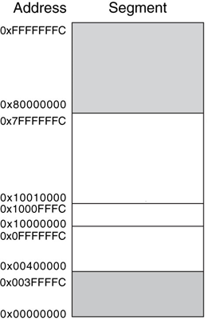
MIPS Memory Map
Reserved
Stack
$sp = 0x7FFFFFFC
Dynamic Data
Heap
Global Data
$gp = 0x10008000
Text
PC = 0x00400000
Reserved
Figure 6.31 MIPS memory map

Slide 54
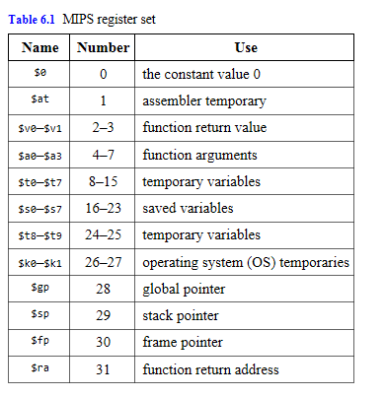
MIPS Register Set
Copyright © 2013 Elsevier Inc. All rights reserved.

Slide 55
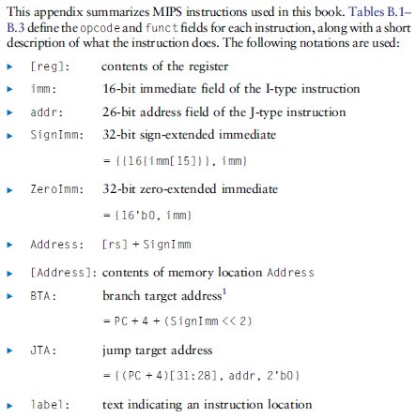
MIPS Instruction Set
Copyright © 2013 Elsevier Inc. All rights reserved.

Slide 56
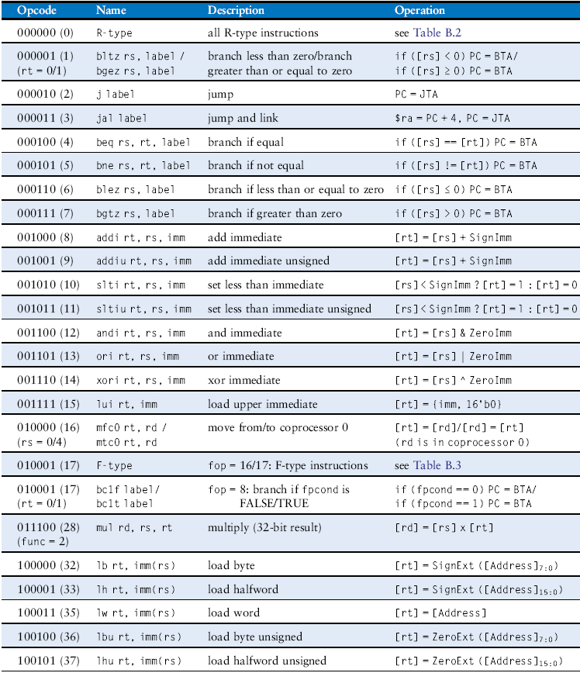
MIPS Instruction Set
Table B.1 Instructions, sorted by opcode
Copyright © 2013 Elsevier Inc. All rights reserved.

Slide 57
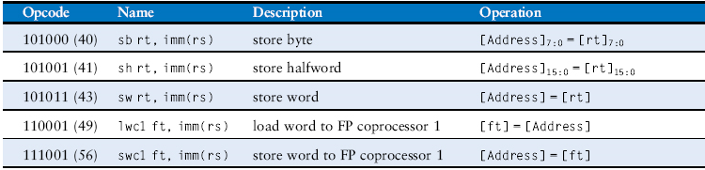
MIPS Instruction Set
Table B.1 Instructions, sorted by opcode
Copyright © 2013 Elsevier Inc. All rights reserved.

Slide 58
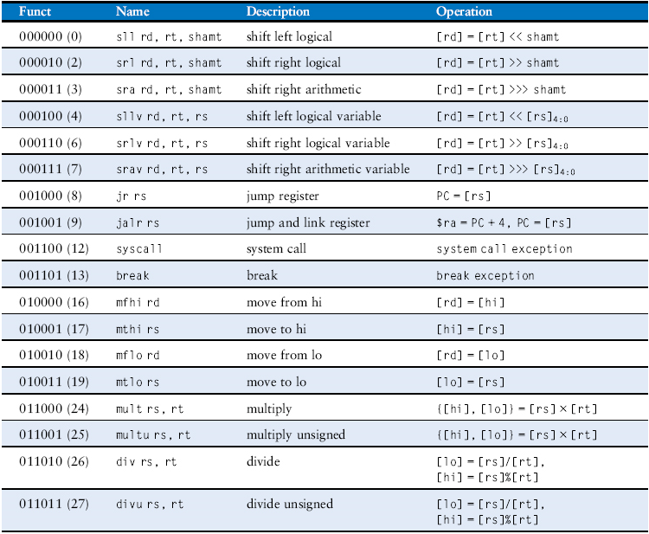
MIPS Instruction Set
Table B.2 R-type instructions, sorted by funct field
Copyright © 2013 Elsevier Inc. All rights reserved.

Slide 59
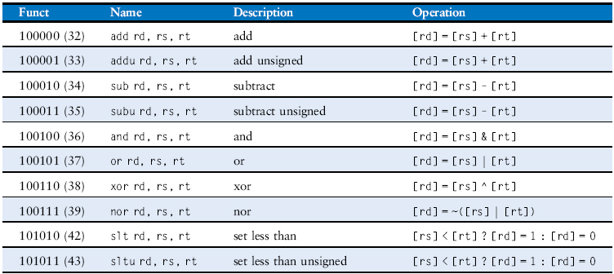
MIPS Instruction Set
Table B.2 R-type instructions, sorted by funct field
Copyright © 2013 Elsevier Inc. All rights reserved.

Slide 60
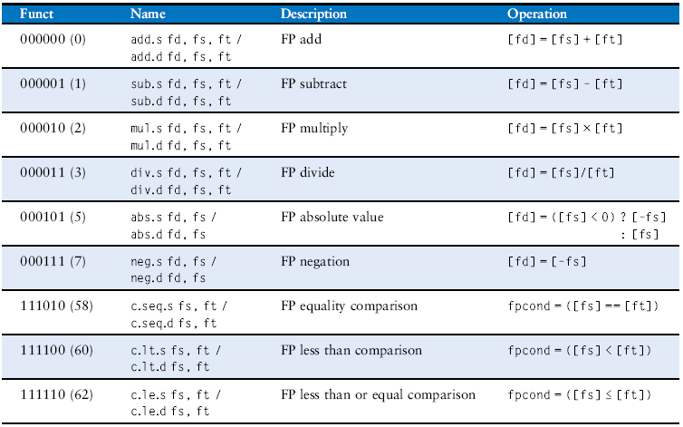
MIPS Instruction Set
Table B.3 F-type instructions (fop = 16/17)
Copyright © 2013 Elsevier Inc. All rights reserved.

